Slide 1

Project:
Measuring Pollution Based on Vehicle Count Design
Team Members:
Shivam
Swapna
Saheb
Reema

Slide 2
Overview
Our traffic monitoring system uses smart cameras and object detection technology to keep an eye on the roads. This project delves into the critical relationship between vehicle characteristics and their environmental impact, focusing on CO2 emissions. By leveraging the power of YOLO (You Only Look Once) for object detection and a user-friendly Streamlit application, we provide a comprehensive understanding of pollution generated by different vehicle types.
Objective
Determine the average pollution generated by different vehicle types

Slide 3
Steps included in project
Project Divided into two parts:
Data Analysis and Machine Learning
Object Detection and Streamlit Application

Slide 4
Objective
Determine the average pollution generated by different vehicle types
Data Acquisition:
Data Cleaning and Preprocessing:
Exploratory Data Analysis (EDA):
Feature Engineering:
Selected the most relevant features for modeling based on their correlation with CO2 emissions.
Created new features or transformed existing ones to improve model performance.
Performed statistical analysis to gain insights into data distribution and relationships.
Created visualizations (scatter plots, histograms, bar charts) to illustrate key findings.
Handled missing values, outliers, and inconsistencies in the data.
Converted relevant features to appropriate data types for analysis.
Machine Learning Modeling:
Trained and evaluated various models, including Linear Regression, Random Forest, and Artificial Neural Networks (ANNs), to predict CO2 emissions based on vehicle features.
Optimized hyperparameters and selected the best-performing model.
Downloaded relevant dataset from Kaggle containing vehicle specifications and CO2 emissions.

Slide 5
Objective
Create a user-friendly application to analyze real-world traffic videos and estimate pollution generated by different vehicle types
Data Collection:
Integrated the trained YOLOv8n model to perform real-time object detection and classification in uploaded videos.
Implemented logic to count different vehicle types and estimate their combined CO2 emissions based on the data analysis findings from Slide 1.
Downloaded YouTube videos containing traffic scenes and converted them into a suitable format for object detection.
Annotation and Labeling:
Used Roboflow to annotate and label vehicles (cars, trucks, buses) in the video frames, creating a training dataset.YOLOv8n
Model Training:
Trained the YOLOv8n deep learning model on the labeled dataset using different epochs (20, 100, 50) to optimize detection accuracy.
Streamlit Application Development:
Built an interactive user interface using Streamlit to allow users to upload videos.

Slide 6
Project Part 1st

Slide 7
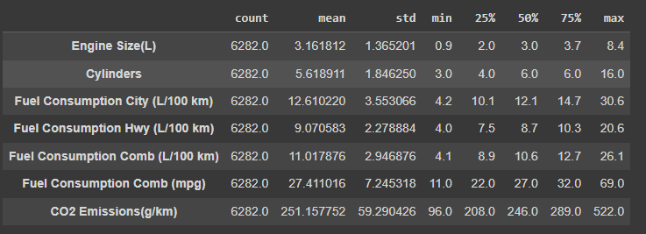
Data Collection - Dataset

Slide 8
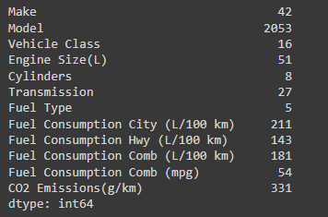
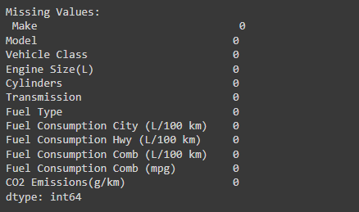
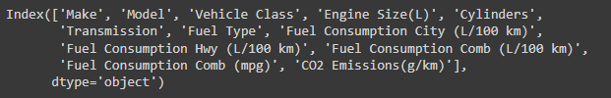
Removed Null Values: Eliminated rows or columns with missing data.
Duplicate Value Removal: Identified and removed duplicate entries to ensure data integrity.
Dropped Null Values : If null values persisted after initial removal, dropped corresponding rows or columns strategically to avoid bias in the analysis.
Removed Outliers: Detected and addressed extreme or unusual data points that could skew the results
Data Cleaning

Slide 9
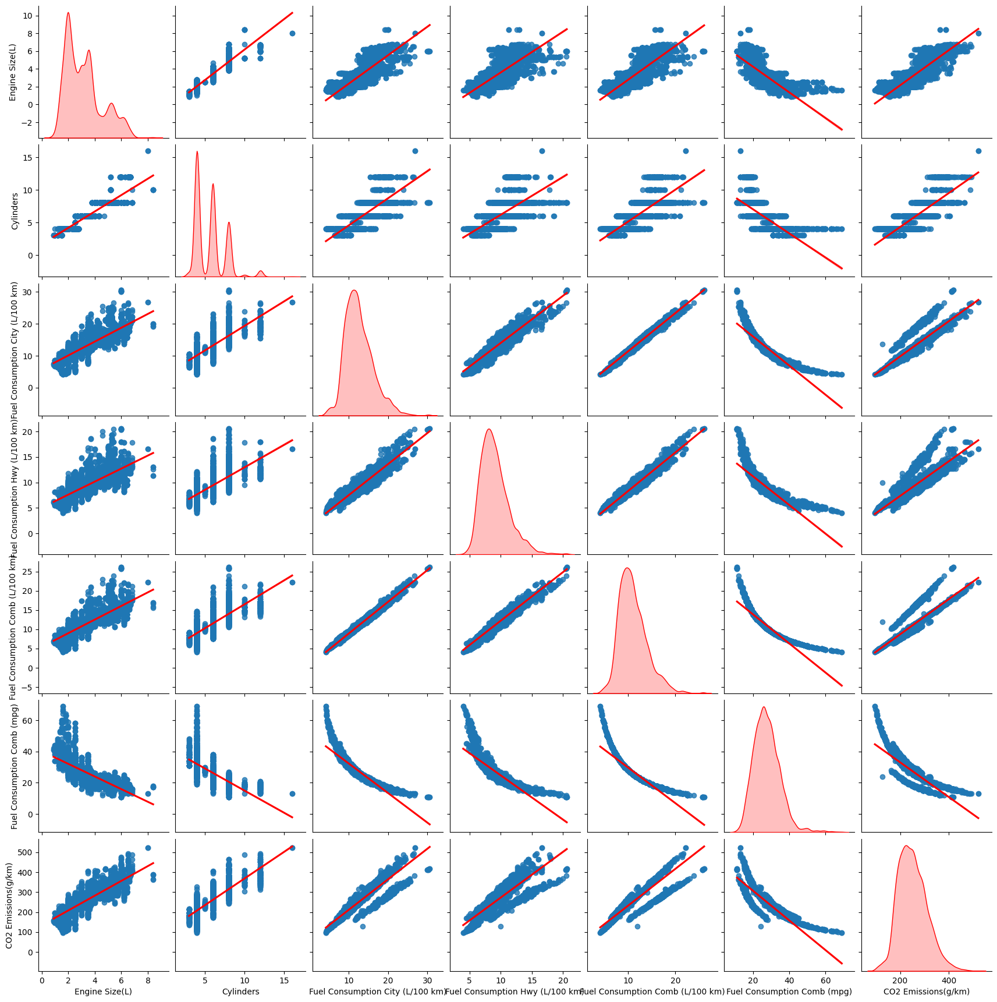
Explanatory Data Analysis

Slide 10
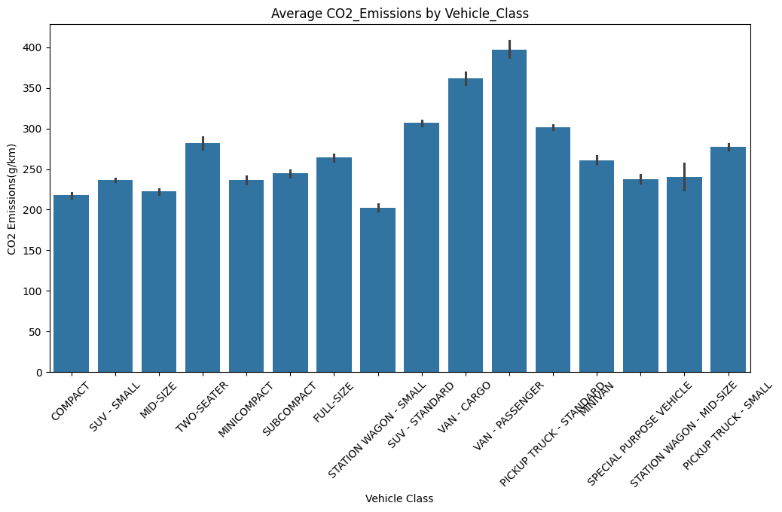
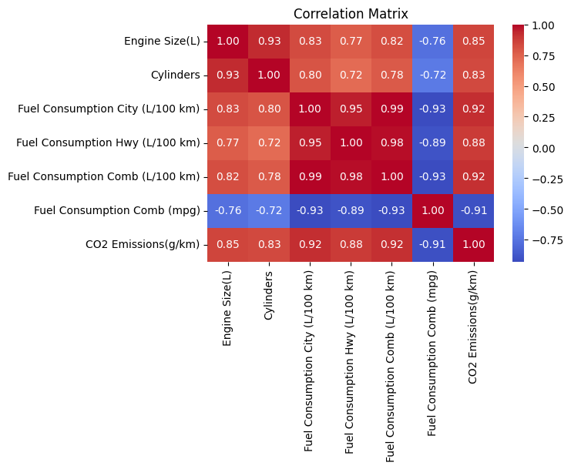
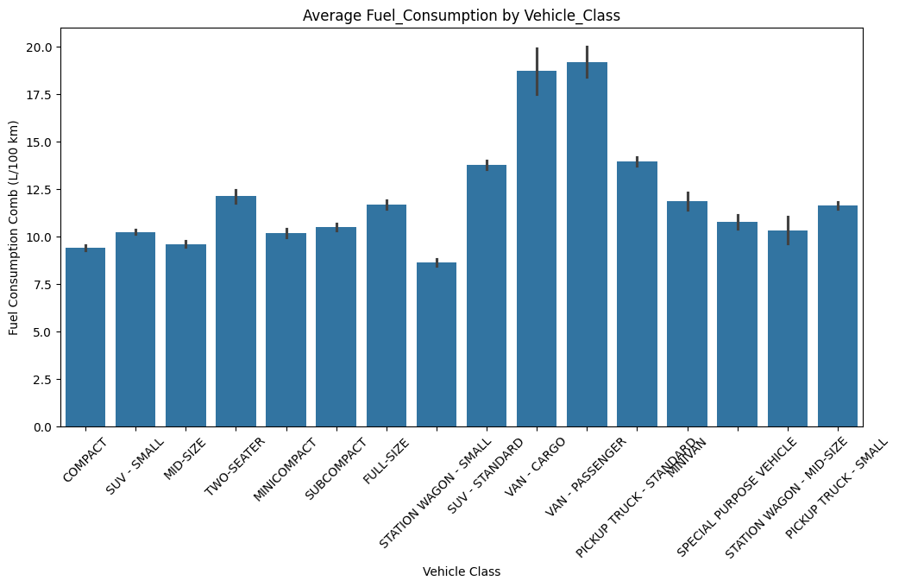
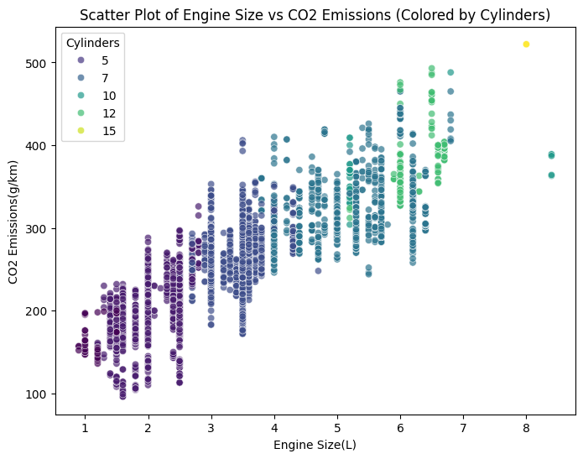

Slide 11
Exploratory Data Analysis (EDA) Insights:
Engine Size Dominates:
Fuel Efficiency Matters:
Vehicle Type Plays a Role:
Cylinder Count Contributes:
Distribution Insights:
Unveiling the Hidden Patterns
A strong positive correlation was found between engine size and CO2 emissions, highlighting its significant impact on pollution.
A strong negative correlation was observed between fuel efficiency (mpg) and CO2 emissions, underscoring the importance of fuel-efficient vehicles for reducing environmental impact.
Different vehicle types exhibited distinct patterns of CO2 emissions, with larger vehicles generally emitting more pollutants.
The number of cylinders moderately influenced CO2 emissions, with higher cylinder counts generally associated with increased pollution.
The distribution of engine sizes revealed a concentration around 2.0-3.0 liters, while larger engines were less common.

Slide 12
One-Hot Encoding:
Drop First: Utilized the drop_first=True parameter to avoid multicollinearity by dropping the first fuel type column, as it can be inferred from the presence or absence of other fuel types. This ensured that our model remains efficient and interpretable.
Feature Transformation:
Cylinders: Similar to engine size, this feature was also ready for modeling as a numerical input.
Fuel Consumption:
Fuel Type: Applied one-hot encoding to the "Fuel Type" column, converting categorical values (E, X, Z) into binary (0/1) columns.
Engine Size: No specific transformation was needed, as the "Engine Size (L)" column is already in a suitable numerical format.
The various fuel consumption columns (city, highway, combined) are already numerical and can be directly used for analysis.
Feature Engineering

Slide 13
Machine Learning
Develop predictive models to estimate CO2 emissions based on vehicle features.
Models Evaluated:
Random Forest
Artificial Neural Network (ANN):
Model Performance Metrics:
Mean Absolute Error (MAE): Measures the average magnitude of errors in predictions.
Root Mean Squared Error (RMSE): Indicates the average deviation of predictions from actual values.
R-squared (R²): Represents the proportion of variance in CO2 emissions explained by the model.
Results:
Random Forest outperformed other models, achieving the lowest MAE and RMSE values and the highest R².
This suggests that the complex relationships between vehicle features and CO2 emissions are better captured by the ensemble nature of the Random Forest model.
Linear Regression:
Simple model assuming a linear relationship between features and CO2 emissions.
Ensemble model combining multiple decision trees for improved accuracy and robustness.
Complex model with interconnected nodes that can capture non-linear relationships in the data.

Slide 14
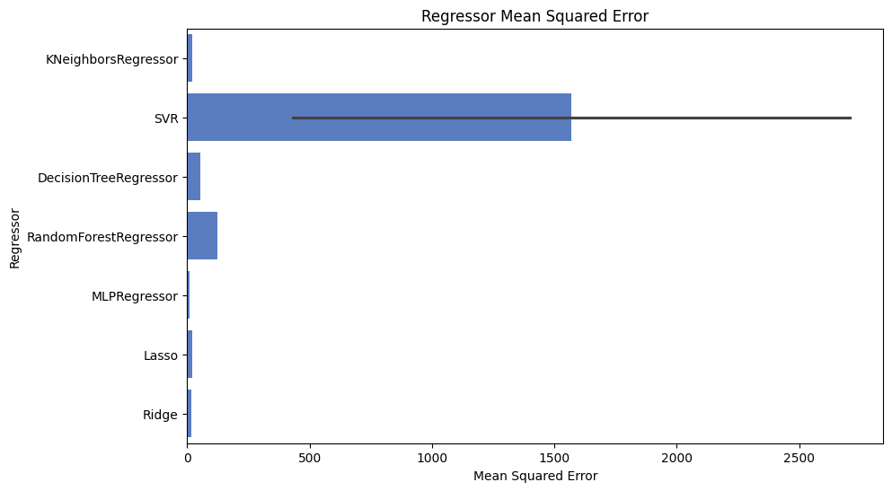
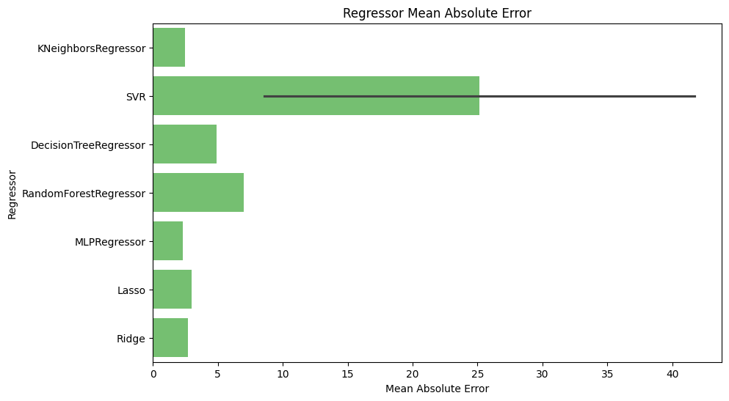

Slide 15
Model | Mean Squared Error (MSE) | Mean Absolute Error (MAE)
KNeighborsRegressor | 22.04 | 2.46
SVR (Linear Kernel) | 431.13 | 8.56
SVR (RBF Kernel) | 2708.59 | 41.74
DecisionTreeRegressor | 54.82 | 4.91
RandomForestRegressor | 123.75 | 6.99
MLPRegressor | 11.24 | 2.27
Lasso | 20.69 | 2.97
Ridge | 16.42 | 2.69
Best Model: Based on the evaluation metrics (lower MSE and MAE are better), the Ridge Regression model demonstrated the best performance in predicting CO2 emissions. It consistently produced the most accurate estimates compared to the other models tested.

Slide 16
Artificial Neural Network (ANN) Architecture and Insights
ANN Architecture:
Hidden Layers:
Output Layer:
Training and Optimization:
Optimizer:
Loss Function:
Neurons representing vehicle features (engine size, cylinders, fuel type, etc.).
Input Layer
Multiple layers with interconnected neurons that process and learn from the data.
Neuron representing the predicted CO2 emissions.
Activation Functions:
Rectified Linear Unit (ReLU) for hidden layers, linear for output layer.
Adam optimizer for efficient gradient descent-based learning.
Mean Squared Error (MSE) to minimize the difference between predicted and actual CO2 emissions

Slide 17
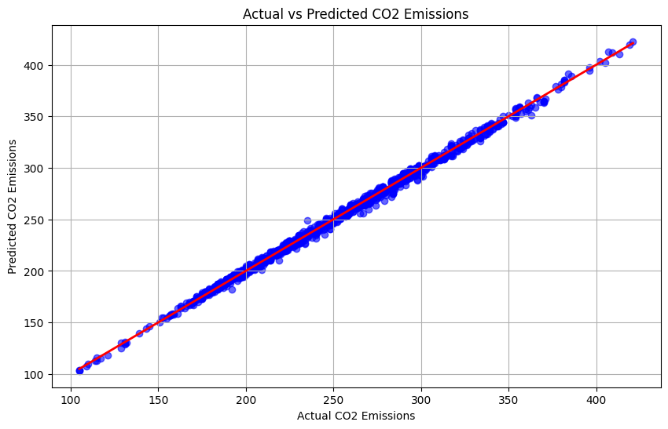
Both Models Excel: Both models demonstrate exceptional performance with perfect R² scores, indicating they explain all the variability in the data.
Model 1 Edges Out: While both models fit the data perfectly, Model 1 exhibits a slight advantage in terms of error metrics.
Lower MAE: Model 1's lower Mean Absolute Error (MAE) suggests it makes predictions with smaller average deviations from the actual values.
Fewer Large Errors: Model 1's lower Root Mean Squared Error (RMSE) indicates it has fewer instances of significant prediction errors.

Slide 18
Project Part 2nd

Slide 19
Object Detection Dataset Creation
1. YouTube Video Selection & Integration
Targeted selection of relevant YouTube videos containing diverse object classes
Seamless integration with Roboflow for efficient frame extraction (1 fps)
2. Precise Manual Annotation
Meticulous labeling of objects in each frame using Roboflow's interface
Bounding box annotation and class labeling for high-quality ground truth data
3. Data Augmentation for Enhanced Performance
Random horizontal flipping for diverse object orientations
Grayscaling to improve robustness to lighting conditions and focus on shape/texture
4. Export for YOLOv8 Training
Dataset exported in a format optimized for training the YOLOv8 object detection model

Slide 20
Training the Model
Epoch Variations:
Conducted three training runs: 50, 100, and 200 epochs
Assessed impact of training time on model performance
Hyperparameter Consistency:
Maintained consistent learning rate, batch size, and augmentations
Isolated the effect of epoch variations on results
Performance Monitoring:
Tracked training and validation loss, precision, recall
Monitored for overfitting and underfitting
Model Selection:
Evaluated each model on a held-out validation set
Utilized standard object detection metrics (mAP at various IoU)
Selected the best-performing model based on validation results

Slide 21
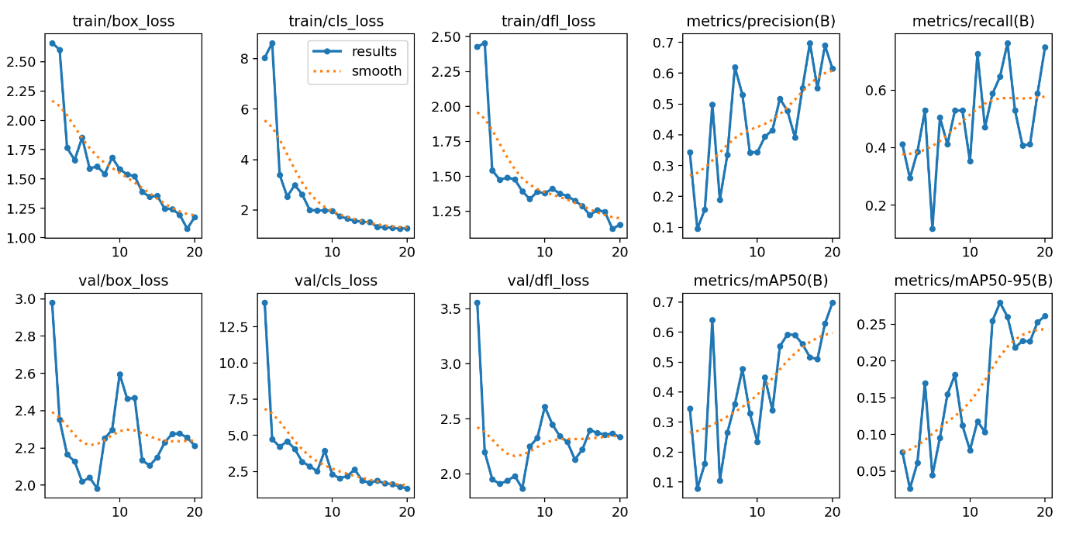
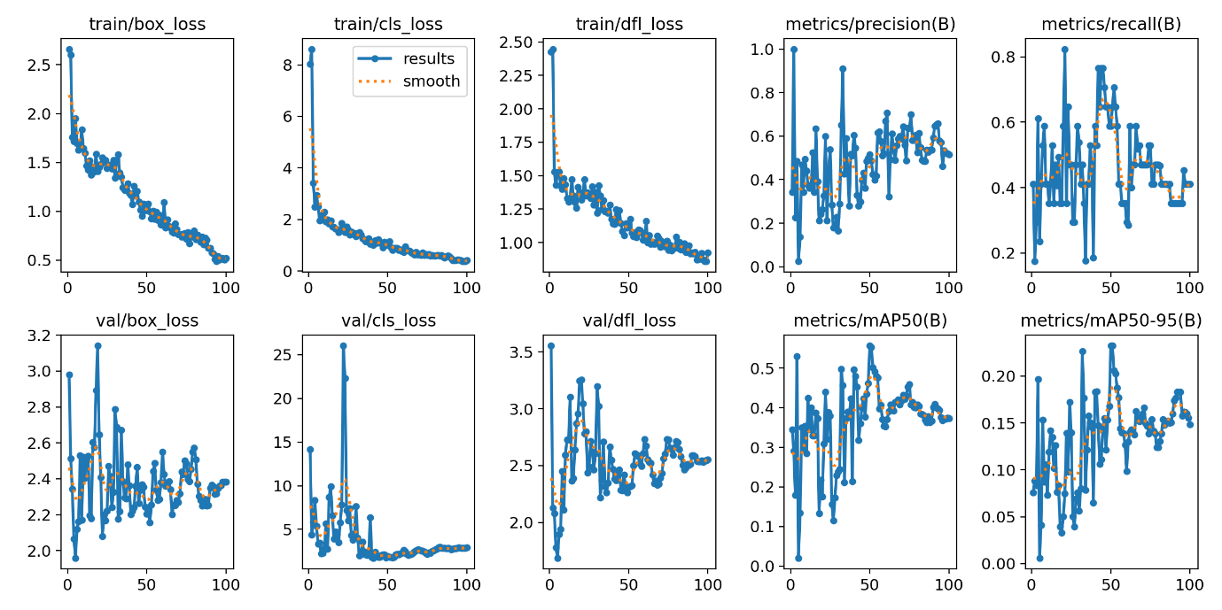
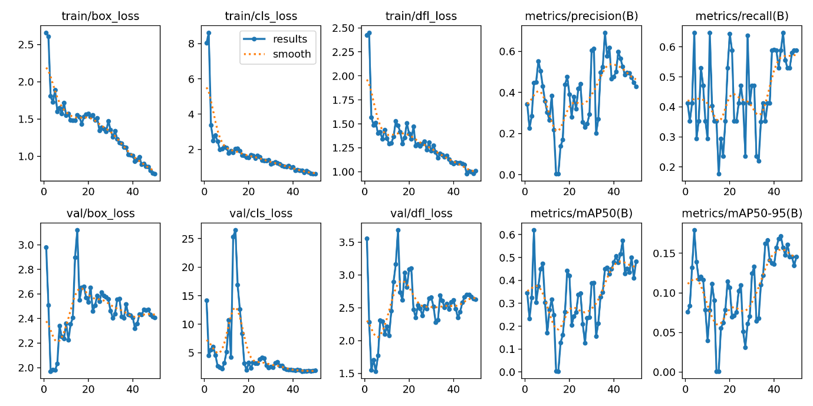
Using 20 Epochs
Using 100 Epochs
Using 50 Epochs

Slide 22
YOLOv8 Model Selection:
Prioritizing Performance
Training Run | Epochs | mAP@50 | mAP@50-95 | Key Observations
1 | 50 | Highest | Highest | Best overall performance, consistent learning, stable metrics
2 | 100 | High | Lower | Overfitting, poor generalization
3 | 200 | Lower | Lower | Less effective learning, lower generalization

Slide 23
Validation the Model
Metric/Aspect | Batch Size 16 | Batch Size 32 | Batch Size 64 | Overall Assessment
Accuracy | Good | Good | Good | Batch 32 slightly better
False Positives | Moderate | Low | Low | Batch 32 & 64 better
False Negatives | Moderate | Moderate | Moderate | Similar across batches
Confidence | High | High | High | Similar across batches
Class Diversity | Good | Good | Good | Similar across batches
Training Speed | Relatively Fast | Fast | Fastest | Batch 64 fastest
Generalization | Needs further testing | Needs further testing | Needs further testing | Unknown
Memory Usage | Low | Moderate | High | Increases with batch size
Batch Size | Accuracy Metrics | Observations
16 | High | More false positives, less consistent detection
32 | Balanced | Good balance of accuracy & efficiency, fewer false positives, consistent detection, good generalization potential
64 | Slightly faster | Similar accuracy to batch size 32

Slide 24
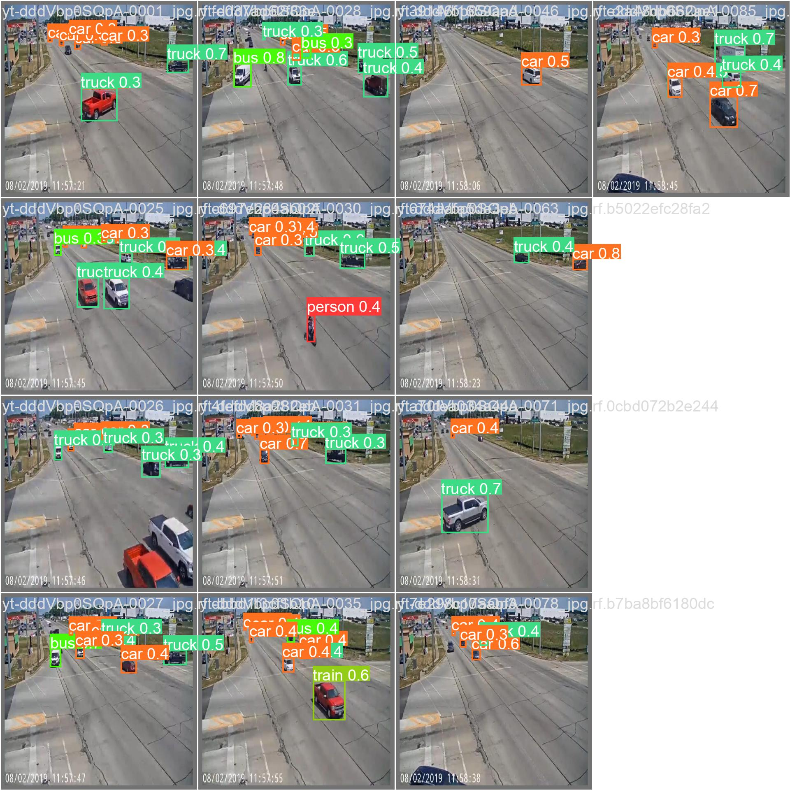
Recommendation:
Batch size 32 is the optimal choice due to its balanced performance, reduced false positives, consistent detection, and promising generalization potential

Slide 25
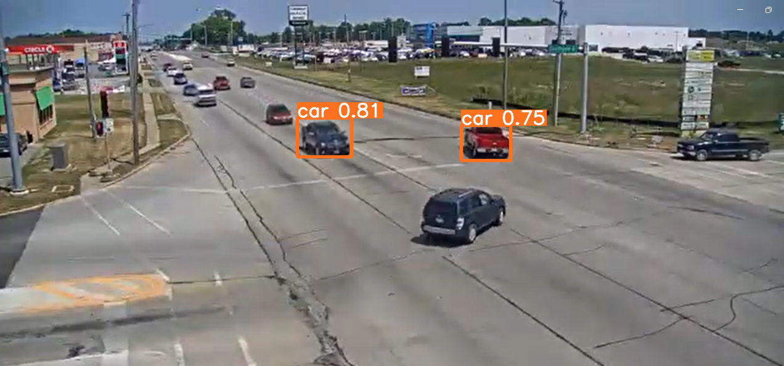
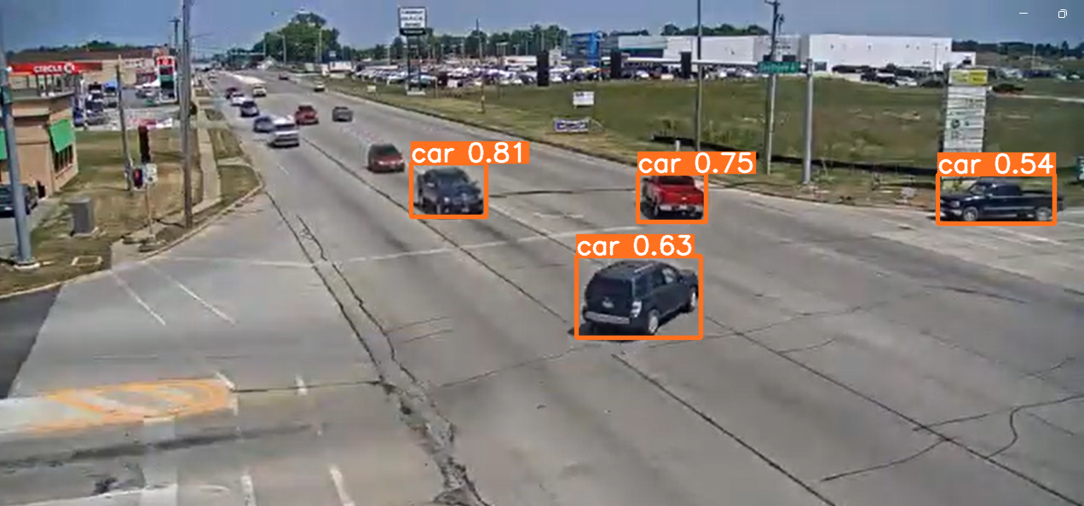
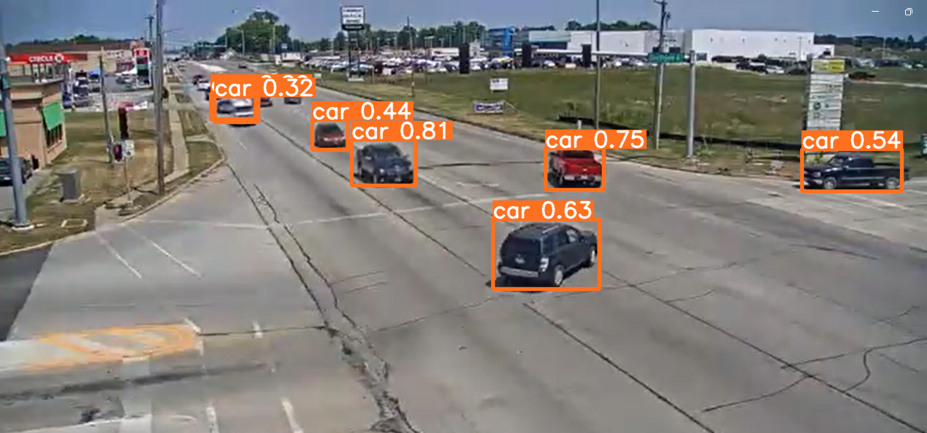
Prediction the Model
Confidence Threshold | Number of Predictions | Accuracy | Precision | Recall | Best Use Case
0.7 | 2 | Very High | High | Low | Scenarios requiring high precision and where false positives are costly.
0.5 | 4 | High | Moderate | Moderate | General purpose detection, balancing precision and recall.
0.2 | 6 | Low | Low | High | Scenarios where missing objects is very costly, even if there are false alarms.

Slide 26
Which is Best?
The "best" confidence threshold depends on your specific use case and the relative importance of precision and recall. There's no one-size-fits-all answer.
If you prioritize accuracy and are willing to sacrifice some recall, the 0.7 threshold might be best.
If you need a balance between accuracy and detecting most objects, the 0.5 threshold is a good choice.
If you absolutely cannot miss any objects, even if it means some false positives, the 0.2 threshold is the most suitable.

Slide 27
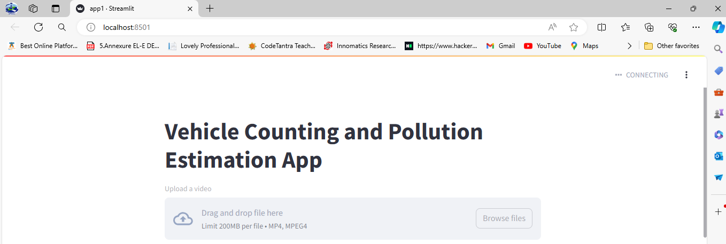
Building Model for User
User Interface:
The application presents a simple, intuitive interface using Streamlit.
The primary feature is a prominent file uploader where users can select their video for analysis.

Slide 28
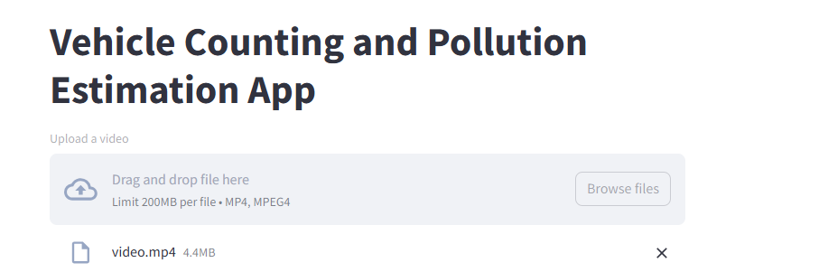
2. Video Processing and Object Detection:
Upon uploading, the video is processed frame by frame.
The integrated YOLOv8 model analyzes each frame to detect and identify vehicles.
Detected vehicles are enclosed in bounding boxes and counted.

Slide 29
3. Output Display:
The processed video is displayed in the application with real-time bounding boxes highlighting the detected vehicles (cars, trucks, buses).
Each bounding box is color-coded or labeled to indicate the vehicle type (car, truck, or bus).
The total count of each vehicle type identified in the video is presented prominently.
The estimated total CO2 emissions for each vehicle type and the overall emissions for all vehicles in the video are displayed

Slide 30


Slide 31
Conclusion:
This project provides a valuable tool for understanding the environmental impact of different vehicle types and empowers individuals, policymakers, and urban planners to make informed decisions for a more sustainable future. By leveraging data analysis and AI, we can actively contribute to reducing emissions and promoting eco-friendly transportation options

Slide 32
Future Scope of this project:
Real-Time Emissions Monitoring:
Emission Reduction Strategies:
Public Awareness and Education:
Expansion of Vehicle Detection:
Integrating the developed model and YOLO-based object detection into existing traffic monitoring systems to provide real-time feedback on traffic composition and emissions. This can aid in dynamic traffic management and pollution control strategies.
Developing data-driven recommendations for policymakers and urban planners to incentivize the use of low-emission vehicles, optimize public transportation routes, and design eco-friendly urban environments.
Creating user-friendly interfaces and visualizations to raise public awareness about the environmental impact of their transportation choices, encouraging the adoption of sustainable practices.
Training the YOLO model on a larger and more diverse dataset to improve its ability to accurately identify a wider range of vehicle types, including electric and hybrid vehicles.
Download Data set and 1st part of Project: -
https://drive.google.com/drive/folders/1cXh_Brl2EqZyUxi4KEW9ie-003tPBWNl?usp=sharing

Slide 33

Special Thanks
With deep gratitude, we extend our heartfelt thanks to Sh. Sai Charan Karri Sir for his invaluable guidance, unwavering support, and constant motivation throughout this project. His expertise and mentorship have been instrumental in our success.
Thank you, Sir!

